Slide 1


Predicting Customer Churn in the Telecommunications Industry
Leo Siu-Yin

Slide 2
Why Predict Customer Churn?
Getting new customers is much more expensive than retaining existing ones. Some studies have shown that it costs six to seven times more to acquire a new customer than to keep an existing one.
Not only do loyal customers help sales, but they are also more likely to buy high-margin supplemental goods and services.
According to BeyondPhilosophy.com:
“Loyal customers reduce costs associated with consumer education and marketing, especially when they become Net Promoters for your organization.”
Hence it is important to be able to proactively determine the customers most at risk of leaving and take preventative measures against this.

Slide 3

Project Goals
Factors of Customer Churn
Build Suitable Model
Predict Customer Churn

Slide 4
Project Stages
Data Cleaning, EDA
Data Interpretation
01
02
03
04
Telco Customer Data
Model Selection, Threshold Tuning
3 numerical, 15 categorical One-hot encoding
Feature Selection (correlation)
Feature Selection (Random Forest Classification)
Factors that affect churn
Impact on telcos
from IBM Data Sets, Kaggle
GridSearchCV
Compare Models (based on class 1)
Threshold Tuning using F1

Slide 5






Tools Used

Slide 6
Data Clean and Exploratory Data Analysis
Data set has 26.5% churn.
Check that each customer id is unique.
Check for data set imbalance.
Replace blank spaces in total charges column, convert to numerical data type.
Dropped 7 features that have high correlation values >0.6, and 1 feature of little effect on Churn.
9 Categorical features (One-hot encoding), 3 Numerical features
16 feature selection down to 11 features through Random Forest Classification.

Slide 7
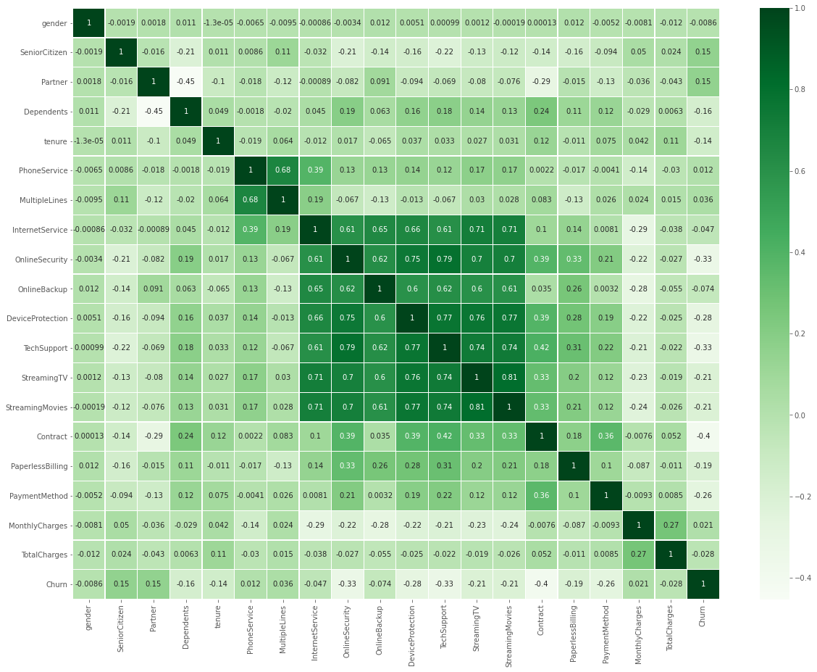
Data
Highly correlated features were dropped.

Slide 8
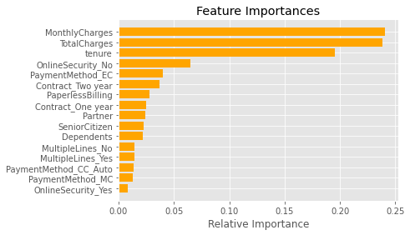
Features selected by
Random Forest Classification

Slide 9
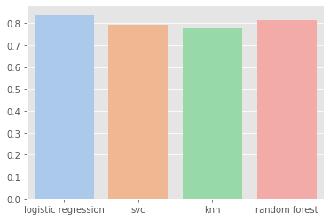
Data
AUC ROC

Slide 10
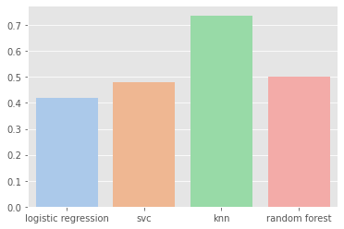
Data
Log Loss

Slide 11
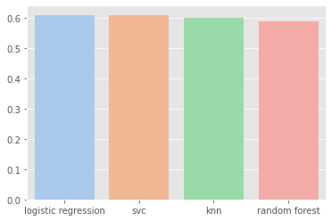
Data
Precision

Slide 12
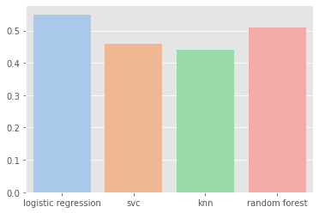
Data
Recall

Slide 13
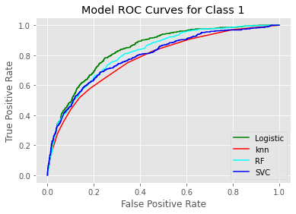
Tuning Hyerparameters
from GridSearchCV
Model | Parameters | AUC ROC | Log Loss | F1
Logistic Regression | C = 5.0941, Penalty = L2, Solver = lbfgs | 0.838 | 0.42 | 0.58
KNN | n neighbours = 15 | 0.775 | 0.7371 | 0.51
Random Forest | n estimators = 300, criterion: 'gini' | 0.815 | 0.5027 | 0.55
SVC | C = 1, Kernel = Linear , Gamma =1 | 0.793 | 0.4811 | 0.53

Slide 14
Tuning threshold in Logistic Regression Model
F-Measure = (2 * Precision * Recall) / (Precision + Recall)
Based on fmax
Threshold = 0.5
Class | Precision | Recall | f1
1 | 0.61 | 0.55 | 0.58
Threshold = 0.361258
Class | Precision | Recall | f1
1 | 0.52 | 0.78 | 0.62

Slide 15
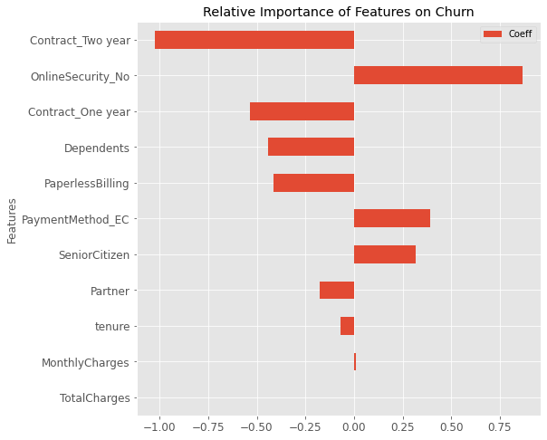
Top Features

Slide 16
Conclusions
To reduce customer churn, telcos need to focus on:
Longer term contract plans for customers.
Provide online security for customers.

Slide 17

THANKS!
Do you have any questions?
syleo22@gmail.com
https://github.com/syleo22/SiuYin_Projects
https://www.linkedin.com/in/syleo/
Please keep this slide for attribution

